Slide 1
Topics to be covered :
UNIT-2. STACK and QUEUE
1. STACK : Basic Stack operations, Stack applications: Conversion of Expression (Infix to Postfix), Evaluation of Expressions.
2.QUEUE : Queues, Circular Queues, Queue applications.
Upon completion you will be able to
Explain the design, use, and operation of a stack
Implement a stack using an array and linked list structure.
Explain the design, use, and operation of a Queue
Implement a queue using an array and linked list structure

Slide 2
1. What is STACK ?
2. Basic Stack operations and Implementation
3. Stack applications
4. Conversion of Expression (Infix to Postfix),
5. Evaluation of Expressions.
6.what is QUEUE ?
7. Basic Queue Operations and Implementation,
8. Queue applications.
8.What is Circular Queue and Implementations,

Slide 3
What is Stack ?
A stack is a linear data structure used to store an ordered, linear sequence of elements.
A stack operates according to the Last In – First Out LIFO principle, which states that the element that was added ( PUSHED) last will be deleted-(POPED) first.
In other words the additions-PUSH and deletions –POP of data/items are restricted at one end, called the top.
If we insert/push a data series into a stack and then remove/pop it, the order of data is reversed.

Slide 4
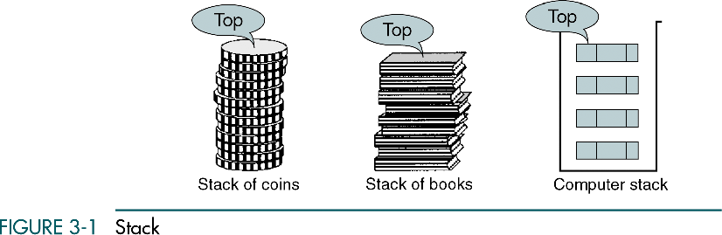

Slide 5
3.1 Basic Stack Operations
The stack concept is introduced and three basic stack operations are discussed.
3.2 Stack Linked List Implementation
In this section we present a linked-list design for a stack. After developing the data structures, we write pseudocode algorithms for the stack ADT.
3.3 C Language Implementations
This section presents a simple non-ADT implementation of a stack. We develop a simple program that inserts random characters into the stack and then prints them.
3.4 Stack ADT
We begin the discussion of the stack ADT with a discussion of the stack structure and its application interface. We then develop the required functions.
3.5 Stack Applications
Three basic application problems-parsing, postponement, and backtracking-are discussed and sample programs developed. In addition, several other stack applications are presented, including the classic Eight Queens problem.
3.6 How Recursion Works
This section discusses the concept of the stack frame and the use of stacks in writing recursive software
2. Basic Stack operations and Implementation
There Can be Three basic opérations :
Push Opération
Pop Opération
Stack Top Opération

Slide 6
PUSH-Operation:
The insertion of a new element into a stack is implied by the PUSH operation.
The top of the stack is always where a new element is added, so we must always check to see if it is full by using the formula TOP=Max-1.
In the case that this condition is true, the Stack is full and no other elements may be added. Even if we attempt to add the element, a Stack overflow message will be shown.
Algorithm PUSH-Operation: Step-1: If TOP = Max-1 Print “Overflow” Goto Step 4 Step-2: Set TOP= TOP + 1 Step-3: Set Stack[TOP]= ELEMENT Step-4: END

Slide 7
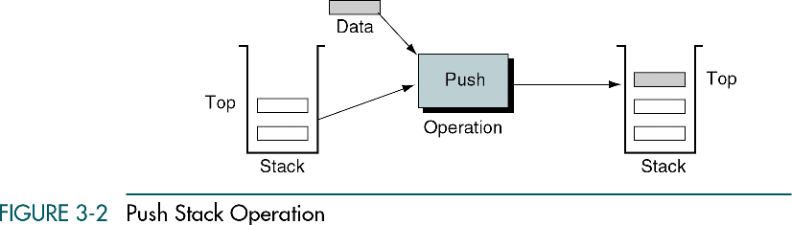

Slide 8
2. POP-Operation:
The deletion of an element from a stack is implied by the POP operation. i.e POP operation denotes removing a stack element.
Make sure to verify that the Stack Top is NULL, i.e., TOP=NULL, before deleting an element.
In the event that this condition is met, the Stack will be empty, making deletion operations impossible.
Even if deletion attempts are made, the Stack Underflow warning will be produced.
Algorithm for POP operation: Step-1: If TOP= NULL Print “Underflow” Goto Step 4 Step-2: Set VAL= Stack[TOP]
Step-3: Display the VAL as popped element Step-3: Set TOP= TOP-1 Step-4: END

Slide 9
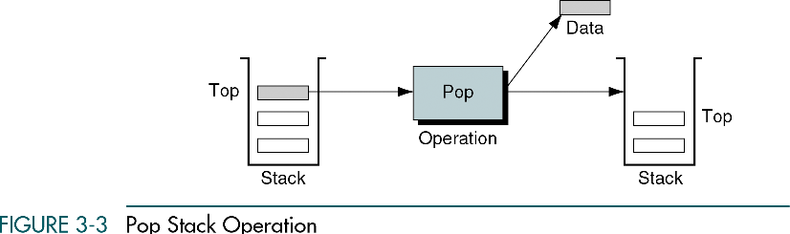

Slide 10
3. STACK TOP/PEEK:
The stack top / peek operation retrieves the element at the top of the stack without removing it.
This operation returns the element at the current top of the stack without modifying
the stack itself, as shown in the figure.
The STACK TOP operation is employed when it is necessary to return the value of the topmost stack element without erasing it. i.e Displaying all the elements of STACK.
This operation first determines whether the Stack is empty, i.e., TOP = NULL; if it is, then the value will be returned; otherwise, an appropriate notice will be displayed.
Algorithm STACK TOP operation: Step-1: If TOP = NULL PRINT “Stack is Empty” Goto Step 3 Step-2: return Stack[TOP] Step-3: END

Slide 11
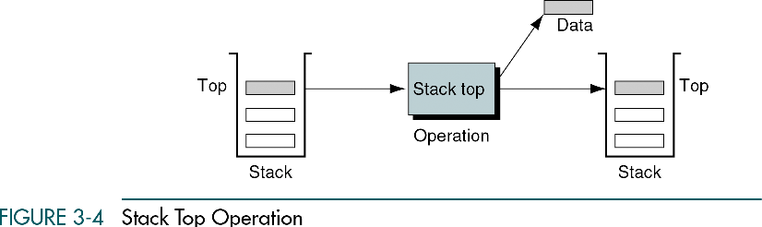

Slide 14
Representation of the Stack and Implementation
A stack may have a set, predetermined size or it may be dynamic, meaning that the size of the stack may fluctuate over time.
Pointer, Array, Structure, and Linked List can all be used to represent it.
STACK implementation Using Array
Prototype Design
void push_stack (int a[], int *top); // a[] is stack array
void pop_stack (int a[], int *top);
void display_stack (int a[], int top);

Slide 15
Applications of Stack Data Structure:
Stacks are widely used in various applications due to their simplicity and efficiency. Following are some, but not limited to, stack applications:
1. Function Call Management: The function call stack is used to manage the execution of functions in a program. When a function is called, its local variables and the return address are pushed onto the stack. When the function completes, the stack is popped, and control returns to the calling function.
2. Expression Evaluation: Stacks are used in evaluating expressions, particularly in converting infix expressions to postfix or prefix notation. This helps in efficient evaluation and simplifies the order of operations.

Slide 16
3. Undo Mechanism in Text Editors: Stacks are used to implement the undo feature in text editors. Each action (like typing, deleting, formatting) is pushed onto the stack, and the undo operation pops the last action, reverting the document to its previous state.
4. Browser History: The back and forward buttons in web browsers use a stack to keep track of the visited pages. Each new page visited is pushed onto the stack, and the back button pops the stack to go to the previous page.
5. Memory Management: The call stack is used in memory management during the execution of programs. Local variables, function calls, and return addresses are managed using a stack.

Slide 17
6. Delimeter Checking : Delimiter checking, or parsing, which entails analysing a source program syntactically, is the most prevalent application of Stack in data structures. Additionally known as parenthesis checking. When a source program written in a programming language, such as C or C++, is translated into machine language, the compiler separates the program into several components, such as variable names, keywords, etc. by moving left to right while scanning The mismatched delimiters are the main issue when translating. We employ a variety of delimiters, such as the parenthesis checks (,), curly braces (,), square brackets (,), and the widely used / and / delimiters. Each opening delimiter must be followed by a corresponding closing delimiter, i.e., each opening parenthesis must be followed by a corresponding closing parenthesis.

Slide 18
Stacks
(Continuation)
Applications

Slide 19
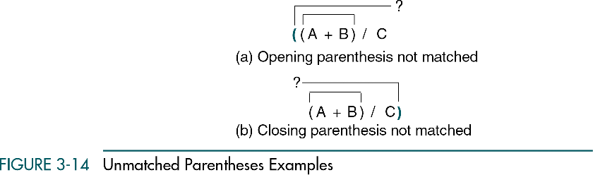
Parse Parentheses

Slide 20
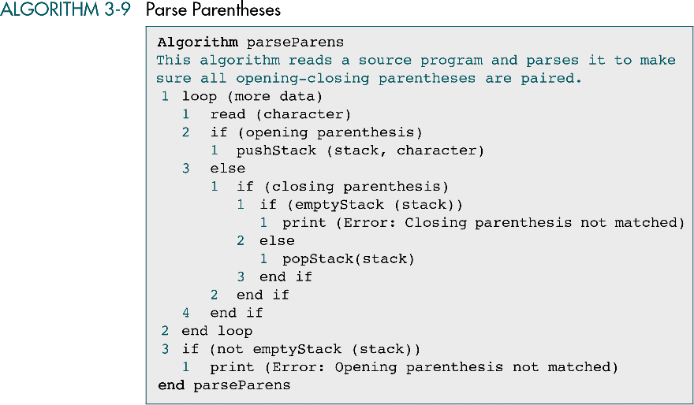

Slide 21
Infix to Postfix Transformation
Infix to Postfix transformation is a very important part of preprocessing of the source codes that are written in high-level languages.
This transformation separates operands from operators

Slide 22
Infix to Postfix Transformation
A * B → AB*
Which transformation is correct?
A*B+C → ? ABC*+
A*B+C → ? → AB*C+
To ensure a correct representation, a precedence rule must be taken into account
Thus, the second representation is correct

Slide 23
Infix to Postfix Transformation
The simplest visible solution is to push all the operators into the stack and then to pop the stack.
However, this will work only for the simplest expression with the two operands A*B → AB*
This will not work for the expression with more than two operands A*B+C ≠ ABC+* because a precedence rule is not taken into account in this solution.
ABC+* → A*(B+C), but we need to represent A+B*C, that is we need to obtain the representation ABC*+

Slide 24
Infix to Postfix Transformation
Let us obtain A+B*C → ABC*+
expression Stack
Copy operand A to output expression. A
Push operator + into stack. A +
Copy operand B to output expression. AB +
Push operator * into stack (Priority of * (incoming) is higher than + (stack) AB *+
Copy operand C to output expression. ABC *+
Pop operator * and copy to output expression. ABC* +
Pop operator + and copy to output expression. ABC*+

Slide 25
Stepwize procedure for infix fo postfix Coversionexpression
1. Scan the infix string from left to right.
2. Initialize an empty stack.
3. If the scanned character is an operand, add it to postfix sting/output string
4. If the scanned character is a left parenthesis ‘(‘, PUSH it to stack.
5. If the scanned character is operator then
While the top operator in stack has equal or higher precedence than scanned
operator then POP the operator present in stack and add it to postfix string.
Later PUSH the scanned character to stack.
6. If the scanned character is a right parenthesis ‘)’, POP and add to postfix string from
stack until an ‘(‘ is encountered. Ignore both '(' and ')'.
7. Repeat step 3-7 till all the characters are scanned.
8. After all character are scanned POP the characters and add to postfix string from
the stack until it is not empty.

Slide 26
Trace on Infix expression to postfix expression - (2+3)*6-2*(4+8)
Steps | Action on input | Postfix/Output expression | STACK
0 | empty | empty | empty
1 | ( →Push on to stack |  | (
2. | 2 → copy on to Output expression | 2 | (
3 | + → Push onto stack | 2 | (+
4 | 3 →copy onto Output expression | 23 | (+
5 | ) →pop stack until ( and Copy + to output expression | 23+ | empty
6 | *→ Push on to stack | 23+ | *
7 | 6 → copy on to Output expression | 23+6 | *
8 | - →Pop * from stack and copy onto Output expression. Push - onto stack | 23+6* | -

Slide 27
Infix expression - (2+3)*6-2*(4+8)
Steps | Action on input | Output expression | STACK
9 | 2 → copy on to Output expression | 23+6*2 | -
10 | * → Push on to stack | 23+6*2 | -*
11. | (→ Push onto stack | 23+6*2 | -*(
12 | 4 → copy onto Output expression | 23+6*24 | -*(
13 | + →push onto stack | 23+6*24 | -*(+
14 | 8→ copy onto Output expression | 23+6*248 | -*(+
15 | ) →Pop + and ( and Copy + onto Output expression | 23+6*248+ | -*
16 | end of expression empty stack and copy Operator * and - onto Ouput expression | 23+6*248+*- | empty

Slide 28
Example -2 Write the trace to convert the given Infix expression to postfix expression
a+a*(b-c) + (b-c) *d
Example -3 Write the trace to convert the given Infix expression to postfix expression
((A+B)-C*(D/E)) + F

Slide 29
Infix to Postfix Transformation
Priorities:
2: * / → Multificative operators
1: + - → Additative operators
0: ( Opening Paranthesis
Pseudo Code to convert Infix expression to Postfix expression
Read infix expression – exp
I =0;
3. Continued.......

Slide 30
3. While ( exp[ I ] not equal to ‘NULL’)
{
if ( exp[ I ] equal to operand )
print operand;
else if ( exp[ I ] equal to '(‘ )
push ‘(‘ on to stack top
else if ( exp[ I ] equal to ')')
{
pop top stack and print until top stack not equal to '('
}
else if ( exp[ I ] equal to operator )
{
while ( priority of stack top operator is >= to priority of incoming operator )
{
pop top stack and print the operator
}
push the incoming operator onto stack;
}
I++;
}

Slide 31
4. pop top stack until empty and print all the operator
5. STOP
Function prototype design for Infix to postfix conversion
void Push(char ch)
char Pop()
int priority(char x)
void infixtopostfix(char *e)

Slide 32
Evaluation of Postfix Expression

Slide 33
Algorithm to evaluate the postfix expression
1. Create a stack to store operands.
2. Scan the given expression from left to right.
3. a) If the scanned character is an operand, push it into the stack.
b) If the scanned character is an operator, POP 2 operands from stack
and perform operation and PUSH the result back to the stack.
4. Repeat step 3 till all the characters are scanned.
5. When the expression is ended, the number in the stack is the final result.

Slide 34
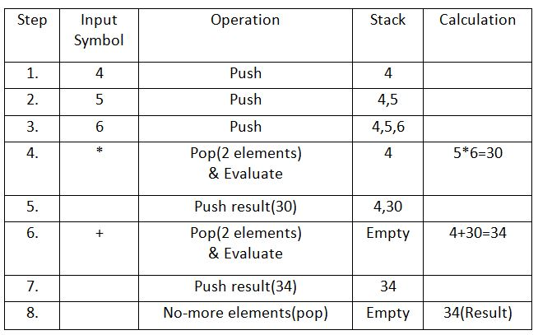
Example:
Let the given expression be “456*+“. We scan all elements one by one.

Slide 35
6. What is QUEUE as a Data structure?
A Queue is also a linear data structure used to store an ordered, linear sequence of elements.
A Queue operates according to the First In – First Out - FIFO principle, which states that the element that was added ( INSERTED) FIRST will be deleted-FIRST.
In other words the additions and deletions –of data/items are done at two ends i.e INSERTION is restricted at one end Called the REAR end and DELETION is restricted at another end called the FRONT end.

Slide 37
3.1 Basic Stack Operations
The stack concept is introduced and three basic stack operations are discussed.
3.2 Stack Linked List Implementation
In this section we present a linked-list design for a stack. After developing the data structures, we write pseudocode algorithms for the stack ADT.
3.3 C Language Implementations
This section presents a simple non-ADT implementation of a stack. We develop a simple program that inserts random characters into the stack and then prints them.
3.4 Stack ADT
We begin the discussion of the stack ADT with a discussion of the stack structure and its application interface. We then develop the required functions.
3.5 Stack Applications
Three basic application problems-parsing, postponement, and backtracking-are discussed and sample programs developed. In addition, several other stack applications are presented, including the classic Eight Queens problem.
3.6 How Recursion Works
This section discusses the concept of the stack frame and the use of stacks in writing recursive software
5. Basic QUEUE operations and Implementation
There Can be Three basic opérations :
EnQueue Opération - Enter/Insertion at REAR end
DeQueue Opération - Delete/retrive at FRONT end
Peek Operation
Queue Front Opération - Retrive from FRONT end
Queue Rear Operation - Retrive from REAR end
Other operations :
isFull() – Validates if the queue is full.
isEmpty() – Checks if the queue is empty.

Slide 38
Insertion Operation : EnQueue()
The enqueue() is a data manipulation operation that is used to insert elements into the Queue.
The following algorithm describes the enqueue() operation in a simpler way.
Algorithm EnQueue() operation: (linear queue) 1 − START
2 – if REAR = Max-1.
print “ QUEUE is full “
Goto Step 6
4 − REAR= REAR +1.
5 − Set Q[REAR] = elelment.
6 – END

Slide 40
Deletion Operation : DeQueue()
The Dequeue() is a data manipulation operation that is used to remove elements from the stack. The following algorithm describes the Dequeue() operation in a simpler way.
Algorithm DeQueue() operation: (linear queue) Step-1 : START
Step-2 : If FRONT = REAR
Print “ QUEUE is Empty “ Goto Step 6
Step-3 : Set VAL= Q[FRONT]
Step-4 : Display the VAL as Deleted element Step-5 : Set FRONT= FRONT+1 Step-6 : END

Slide 42
The peek() Operation - Queue front and Queue Rear operation
The peek() is an operation which is used to retrieve the FRONT MOST element and the REAR MOST element in the queue, without deleting and inserting in it.
Algorithm Queuefront operation: (linear queue)
Step-1 : START
Step-2 : Return Q[ FRONT ] of the queue
Step-3 : END
Algorithm QueueRear operation: (linear queue)
Step-1 : START
Step-2 : Return Q[ REAR ] of the queue
Step-3 : END

Slide 45
The isEmpty() operation
The isEmpty() operation verifies whether the QUEUE is empty. This operation is used to check the status of the Queue with the help of FRONT and REAR pointer.
Algorithm isEmpty() operation:
Step-1 : START
Step-2 : If FRONT=REAR
return TRUE
else
return FALSE
Step-4 : END

Slide 46
The isFull() operation
The isFull() operation verifies whether the QUEUE is full. This operation is used to check the status of the Queue with the help of FRONT and REAR pointer.
Algorithm isFull() operation:
Step-1 : START
Step-2 : If REAR = MAX-1
return TRUE
else
return FALSE
Step-4 : END

Slide 47
Queue Operations Example

Slide 48
Queue Operations Example

Slide 49
Applications of Queue Data structure
This data structure is used whenever there is need for sharing of resources or any tasks to be scheduled for excution at Operating system level or in many software applications.
The scenarios mentioned below are a few systems that use the queue data structure to serve their needs -
Printer Sharing : Queue data structure is used in printers to
maintain the order of pages while printing.
Interrupt handling in computes: The interrupts are operated in the
same order as they arrive, i.e., interrupt which comes first, will be
dealt with first.

Slide 50
Process scheduling in Operating systems: Queues are used to implement round-robin scheduling algorithms in computer systems.
Switches and Routers: Both switch and router interfaces maintain ingress (inbound) and egress (outbound) queues to store packets.
Customer service systems: In developing the call center phone systems, the concept of queues are used where the calls are attended on FIRST COME FIRST SERVE basis.

Slide 51


Slide 52
Representation of the Queue and Implementation
A Queue may have a set, predetermined size or it may be dynamic, meaning that the size of the Queue may fluctuate over time.
Pointer, Array, Structure, and Linked List can all be used to represent it.
Queue implementation Using Array
1. Linear queue : In a linear queue, the traversal through the queue is possible only once,i.e.,once an element is deleted, we
cannot insert another element in its position as we are moving FRONT pointer ahead.
This disadvantage of a linear queue is overcome by a circular
queue, thus saving memory.

Slide 53
2. Circular Queue :
A Circular Queue is an extended version of a Linear queue where the last element of the queue is connected to the first element of the queue forming a circle.
How Circular Queue Works ?
Circular Queue works by the process of circular increment i.e. when we try to increment the pointer and we reach the end of the queue, we start from the beginning of the queue.
Here, the circular increment is performed by modulo division( % ) with the queue size of 5.
That is,
if REAR + 1 == 5 (overflow!), REAR = (REAR + 1)%5 = 0 (start of queue)

Slide 54
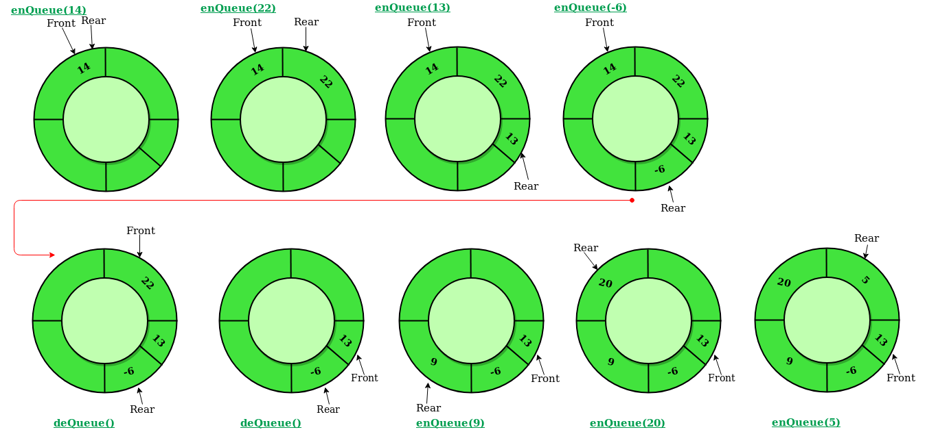
Overview of working of circular queue -Max=5
Initially Rear=- 1 & front =1
Isempty : front = -1
isfull : (Rear + 1) % MAX = Front
Insertion :
1. For First element
set Front =0
2. Else Rear=(Rear+1) % max
Deletion :
1. Last element i.e If Rear = front
set front=rear=-1
2. Else set Front =(Front+1) % max

Slide 55
Important condition for Circular Queue implementation
During Insertion we always increment rear pointer by (rear+1) % Max before any item get inserted at Rear position.
Special Note : if First element is inserted in the queue then set Front = 0
During Deletion we always increment front pointer by (front+1) % Max after any item get deleted from Front position
Special Note : if LAST element is deleted from the queue then set Front = Rear =-1
In the repearted insertion and deletion operation it is observed that when the front poniter is next to the rear pointer and during insertion when rear pointer is incremented by (rear+1) % Max , the value of Rear pointer is always equal to front pointer. In that case QUEUE is full.

Slide 56
Insersion Scanario - 1 For Max=5
Q-DATA | 19 | 69 | 89 | 78 | 100
Index | 0 | 1 | 2 | 3 | 4
Front =0 and Rear = 4 → Front pointer Next of Rear pointer
Enqueue(47) - Rear = (Rear +1) % 5
= (4+1) % 5
= 0 → here rear = front and Queue is full

Slide 57
Insersion Scanario - 2 For Max=5
Q-DATA | vacant | 69 | 89 | 78 | 100
Index | 0 | 1 | 2 | 3 | 4
Front =1 and Rear =4 →Front pointer not Next of Rear pointer
Enqueue(47) - Rear = (Rear +1) % 5
= (4+1) % 5
= 0 → here rear != front and Queue has
space at 0

Slide 58
Insertion Scanario - 3 For max =5
Q-DATA | 19 | 69 | 89 | 78 | 100
Index | 0 | 1 | 2 | 3 | 4
Front =3 and Rear = 2 → Front pointer Next of Rear pointer
Enqueue(47) - Rear = (Rear +1) % 5
= (2+1) % 5
= 3 → here rear = front and Queue is full

Slide 59
Insertion Scanario - 4 For max =5
Q-DATA | 19 | 69 | 89 | VACANT | 100
Index | 0 | 1 | 2 | 3 | 4
Front =4 and Rear = 2 → Front pointer not Next of Rear pointer
Enqueue(47) - Rear = (Rear +1) % 5
= (2+1) % 5
= 3 → here rear != front and Queue has
Space at 3

Slide 60
Enqueue Operation :
As discussed above in Enqueue Operation [Insertion in Q] we will have the following steps:
Algorithm EnQueue() operation: (CIRCULAR Queue)
Step - 1 : If (Rear + 1) % MAX = Front )
Print " Queue Overflow /full " and Goto Step - 4
Step - 2 : If Front = Rear = -1 // inserting FIRST element into queue
Set Front = Rear = 0
Else Set Rear = (Rear + 1) % MAX // subsequent insertions
Step - 3 : Insert the new element i.e. Set Q[Rear] = Element
Step - 4 : End

Slide 61
Dequeue Operation :
As discussed above in Dequeue Operation [Deletion in Queue] we will have the following steps:
Algorithm DeQueue() operation: (CIRCULAR Queue)
Step - 1 : If (Front = -1 )
Print " Queue Underflow /Empty" and Exit
Step - 3 : Delete the element i.e. Set Element = Q[Front]
Step - 3 : If Q has only one left element deleted i.e Front = Rear // queue has to be
made empty
Set Front = Rear = -1
Else Set Front = (Front + 1) % MAX
Step - 4 : return Element

Slide 62
The isEmpty() operation
The isEmpty() operation verifies whether the QUEUE is empty. This operation is used to check the status of the Queue with the help of FRONT and REAR pointer.
Algorithm isEmpty() operation:
Step-1 : START
Step-2 : If (FRONT=-1)
return TRUE
else
return FALSE
Step-4 : END

Slide 63
The isFull() operation
The isFull() operation verifies whether the QUEUE is full. This operation is used to check the status of the Queue with the help of FRONT and REAR pointer.
Algorithm isFull() operation:
Step-1 : START
Step-2 : If ((Rear + 1) % MAX = Front )
return TRUE
else
return FALSE
Step-4 : END

Slide 64
The peek() Operation - Queue front and Queue Rear operation
The peek() is an operation which is used to retrieve the FRONT MOST element and the REAR MOST element in the queue, without deleting and inserting in it.
Algorithm Queuefront operation: (Circular queue)
Step-1 : START
Step-2 : Return Q[ FRONT ] of the queue
Step-3 : END
Algorithm QueueRear operation: (Circular queue)
Step-1 : START
Step-2 : Return Q[ REAR ] of the queue
Step-3 : END

Slide 65
The Display_Queue() operation
The Display_Queue() operation is used to find the Data items present in the QUEUE
Algorithm Display_queue() operation:
Step-1 : START
Step-2 : If (FRONT=-1 and REAR = -1)
print “Queue is Underflow” Goto step 5
Step-3 : Set I=FRONT
Step-4 : if (FRONT < REAR) // Normal content of Q when FRONT has not Crossed REAR
while (I < =REAR)
print Q[I] and Set I=I+1
else
while(I != REAR) // Content of Q where FRONT has Crossed Rear
print Q[I] and Set I= (I +1) % max
Step-5 : END

Slide 66
Fuction prototype Design for circular Queue implementation
void Enqueue(int cq[], int item);
int Dequeue(int cq[]);
int isEmpty();
int isFull();
void Display_Queue(int cq[]);

Slide 67
END of UNIT - II

